Slide 1
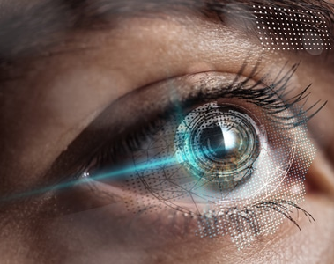
EyeTalk
AI-Based Head and Gaze Controlled Communication System for Motor-Impaired Patients

Slide 2
Software
Project update revolving around software components

Slide 3
Software Components:
Head-Tracking Cursor Control
Where this component is expected to:
Calibrate the user’s head position relative to the screen.
Track (and save) all the user’s head movement.
Convert this head movement into coordinates for the cursor (mouse) to move onto the screen.
Gaze-Tracking Cursor Control
Where this component is expected to:
This module is supposed to track each eye’s Iris center.
Then determine where the user is looking (like right, up, etc…).
Then move the mouse according to where the user is currently looking.

Slide 4
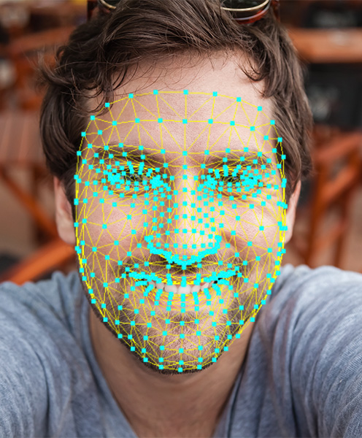
Software Components:
Both modules are done using Google’s cutting-edge AI library called Mediapipe that provides a complete face mesh.
We calculate the Iris center positions and thus also the most important thing in this project.
The Gaze Vector

Slide 5
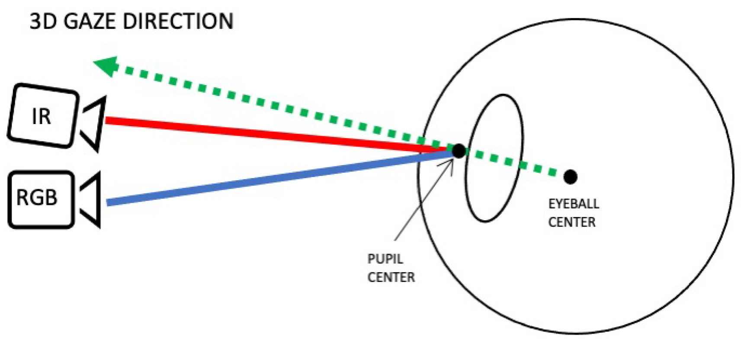
What is a Gaze Vector?
A gaze vector is a normalized 3D direction vector originating from the eye (or head center as we used in our Head-Tracking system) that represents the line of sight in camera or world coordinates.
Imagine holding a laser pointer in your eye. The direction the laser travels is your gaze vector.
It has:
A starting point (eye center or head center).
A direction.
Usually unit length (length = 1).

Slide 6
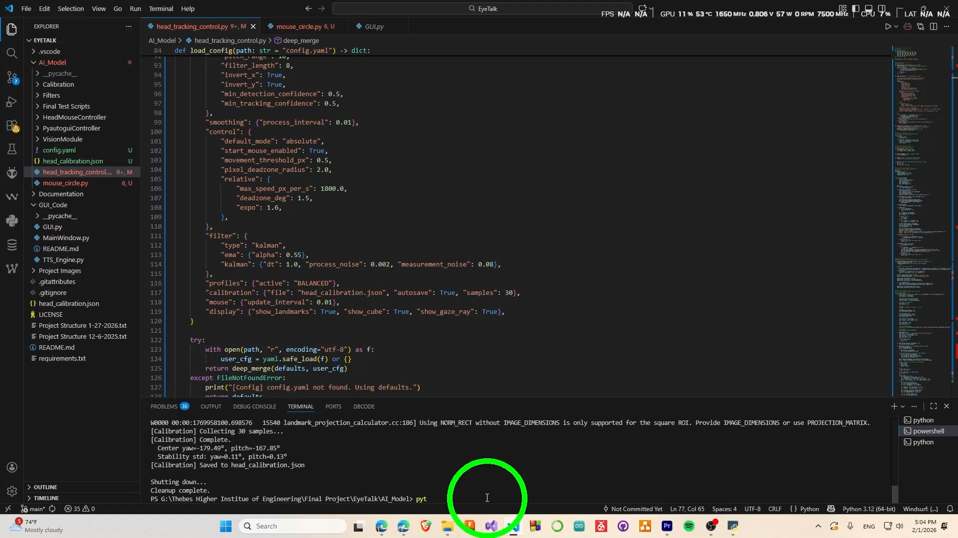
Video Demonstration

Slide 7
Hardware
Explaining all current and future hardware.

Slide 8
Inverter Circuit

Slide 9
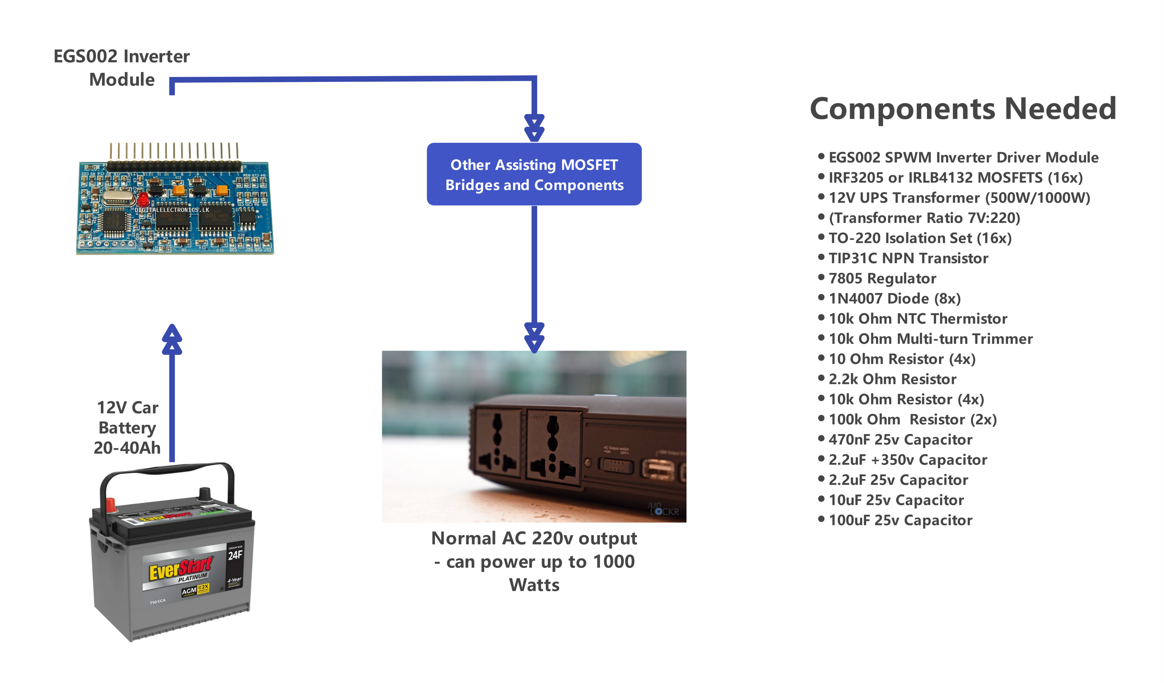
Basic Hardware map

Slide 10
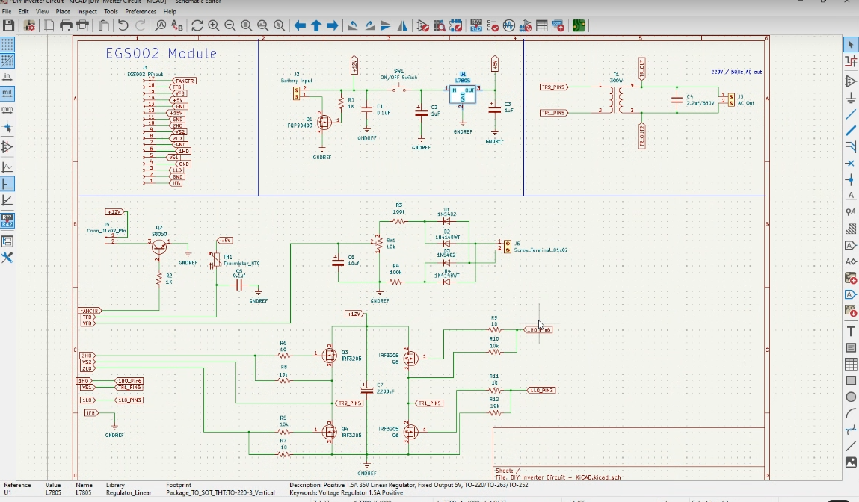
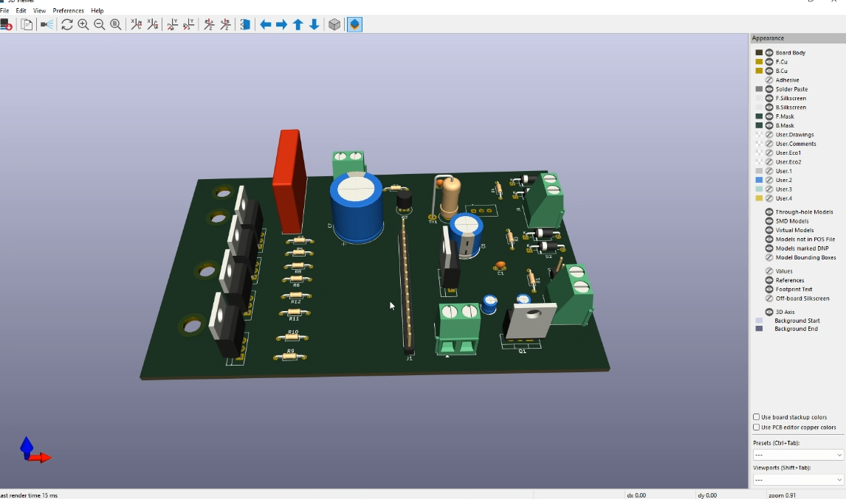
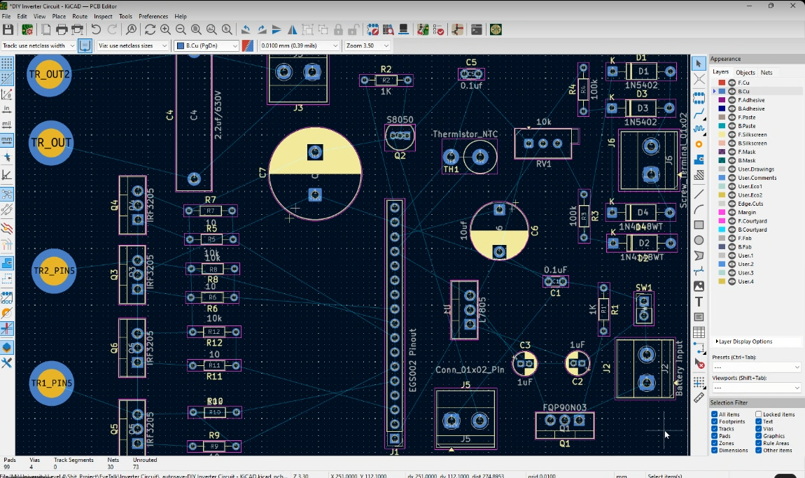
Basic Hardware map

Slide 11
End of Lecture
Thank You

